Slide 1
CyberRead
Szirényi Vivien
Kiss Vivien Brigitta
Mayer Hedda Adrienn

Slide 2

Notes:
our purpose, roles

Slide 3

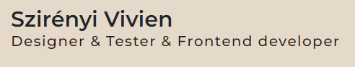

Slide 4
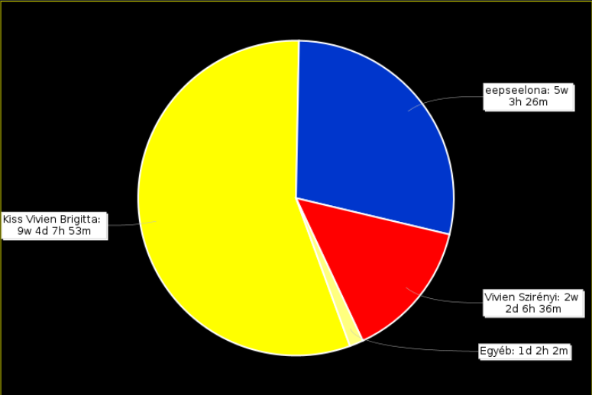
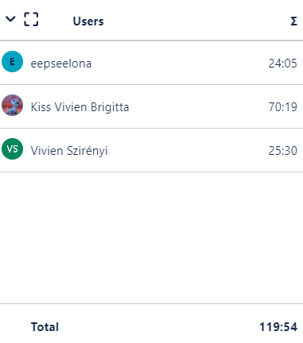

Notes:
management, meetings, communication, jira, roles, teamwork

Slide 5
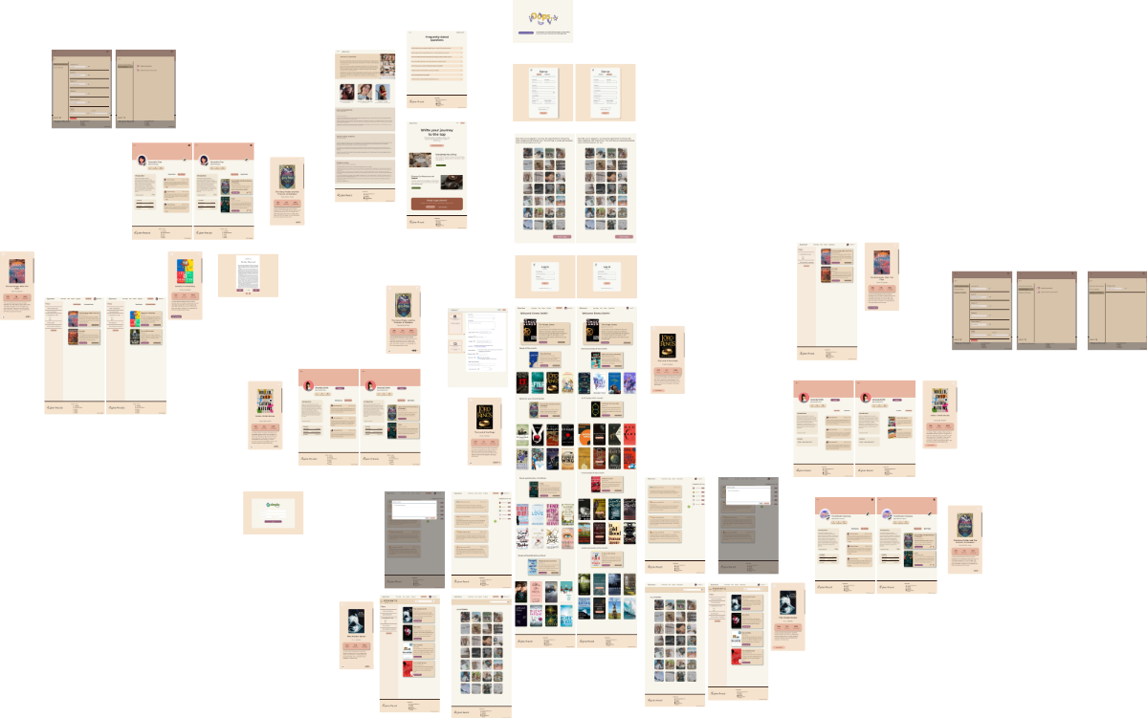

Notes:
figma, my purpose, teamwork,

Slide 6

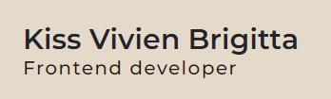

Slide 7
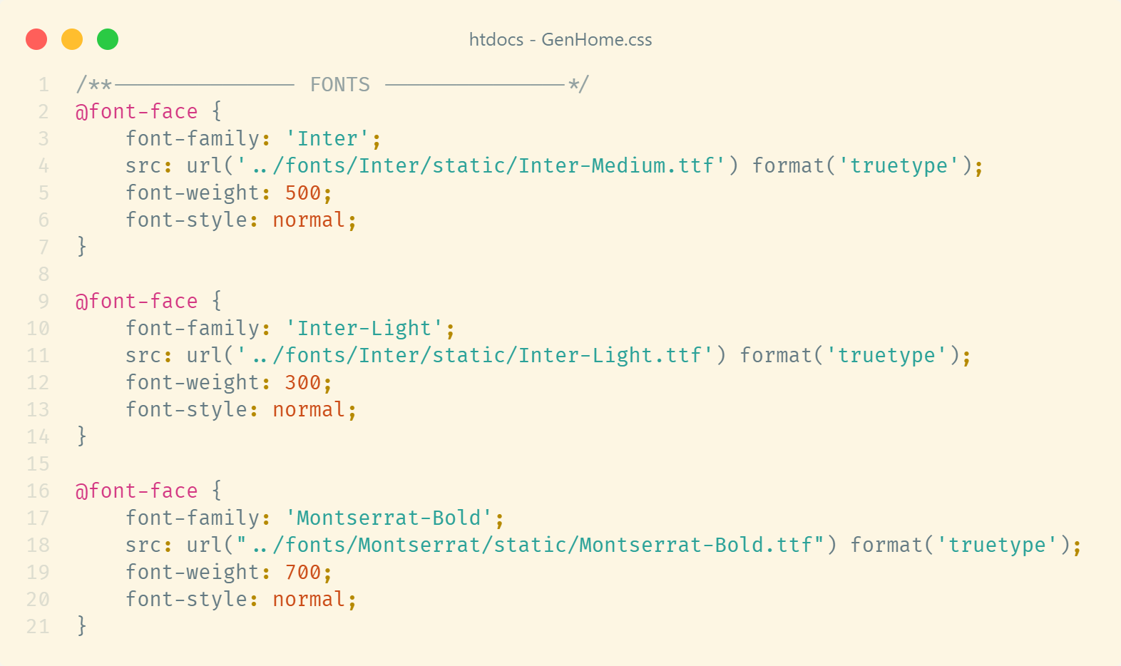
Notes:
Basic HTML, Css, Javascript
Bootstrap icons and styles
Google fonts

Slide 8
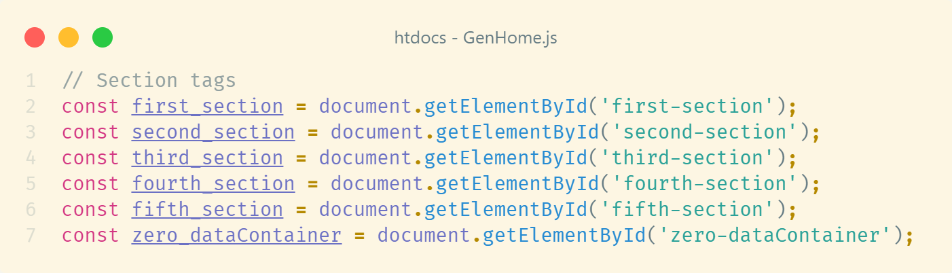
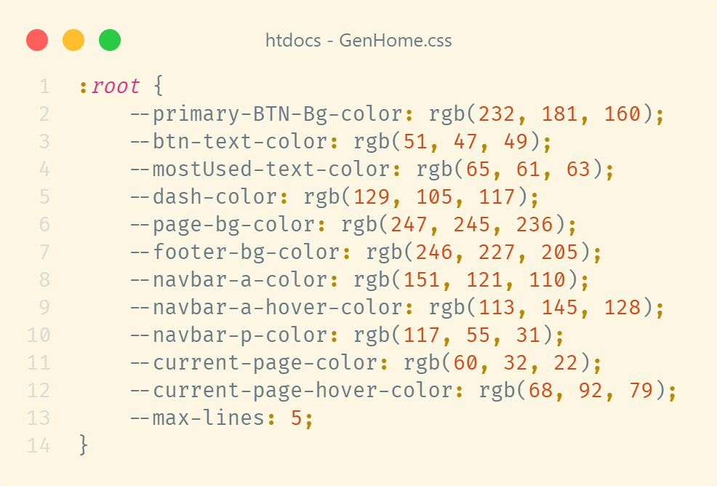
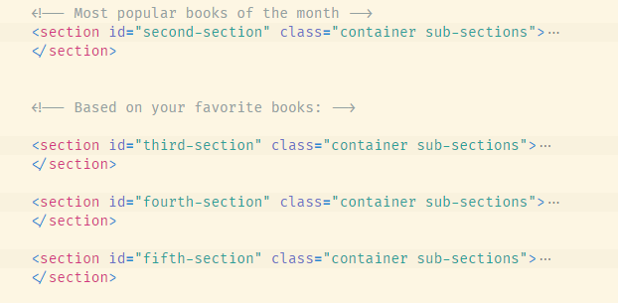
Notes:
Pre defined css colors
section tags
id reference

Slide 9
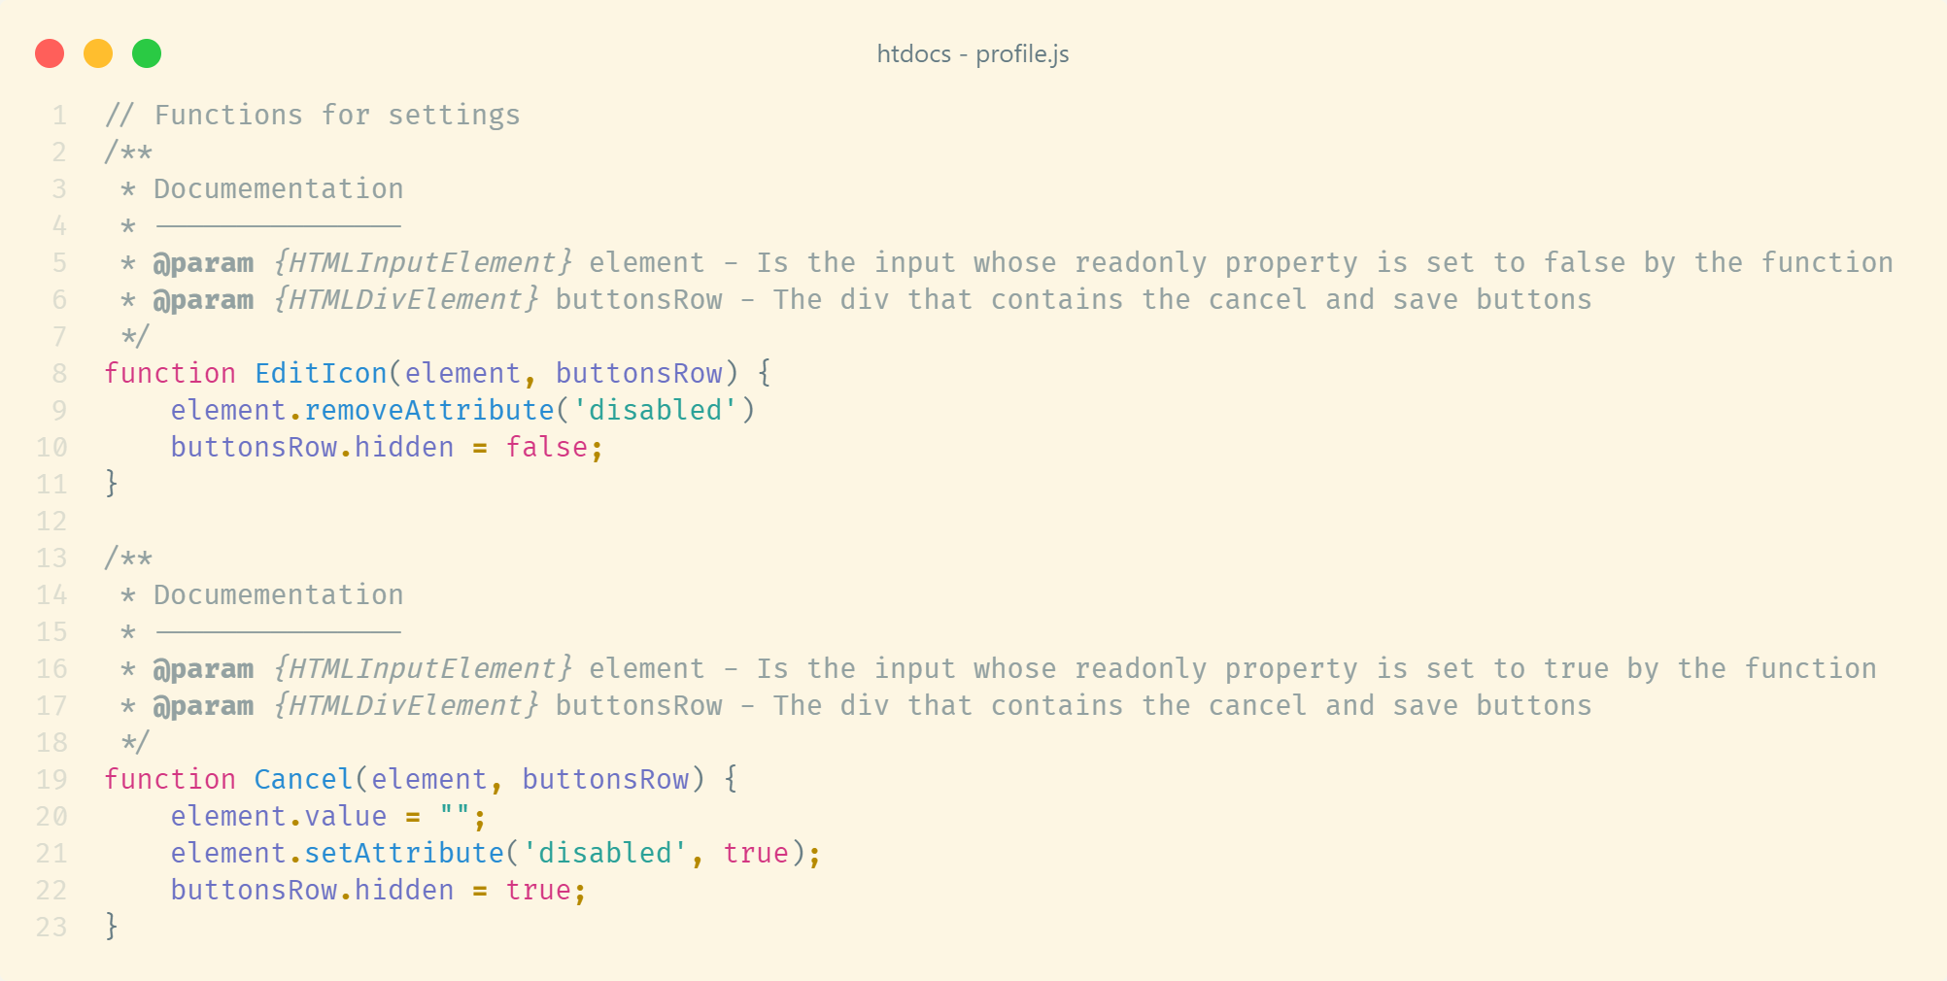
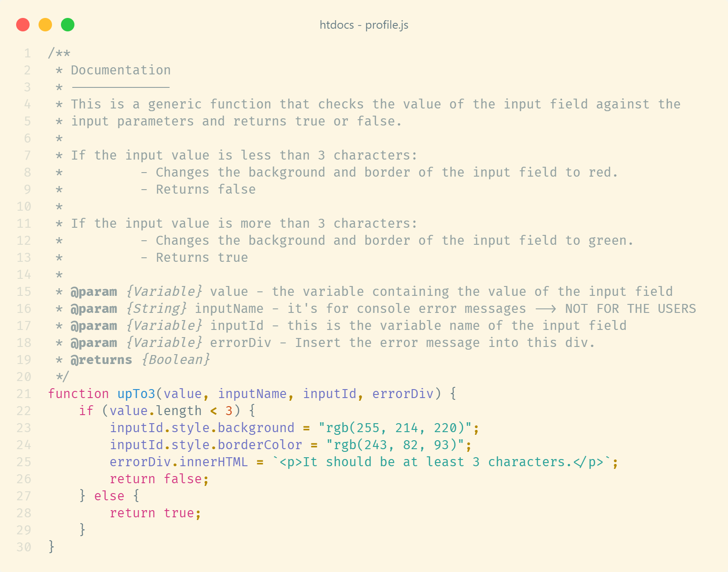
Notes:
punctual validations
reusable functions
documentation above functions

Slide 10
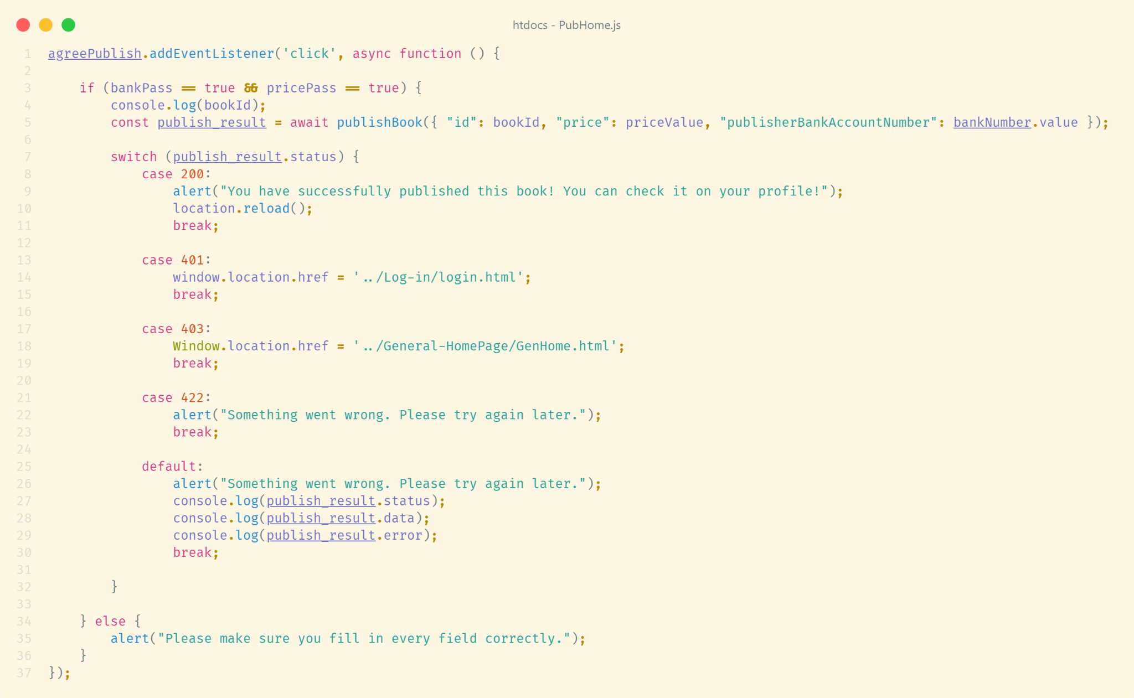
Notes:
page loading controlled by status codes
data loading by status codes
user hasn’t permission
404 page
async functions
fetch api
data → json format

Slide 11

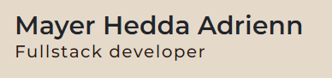

Slide 12
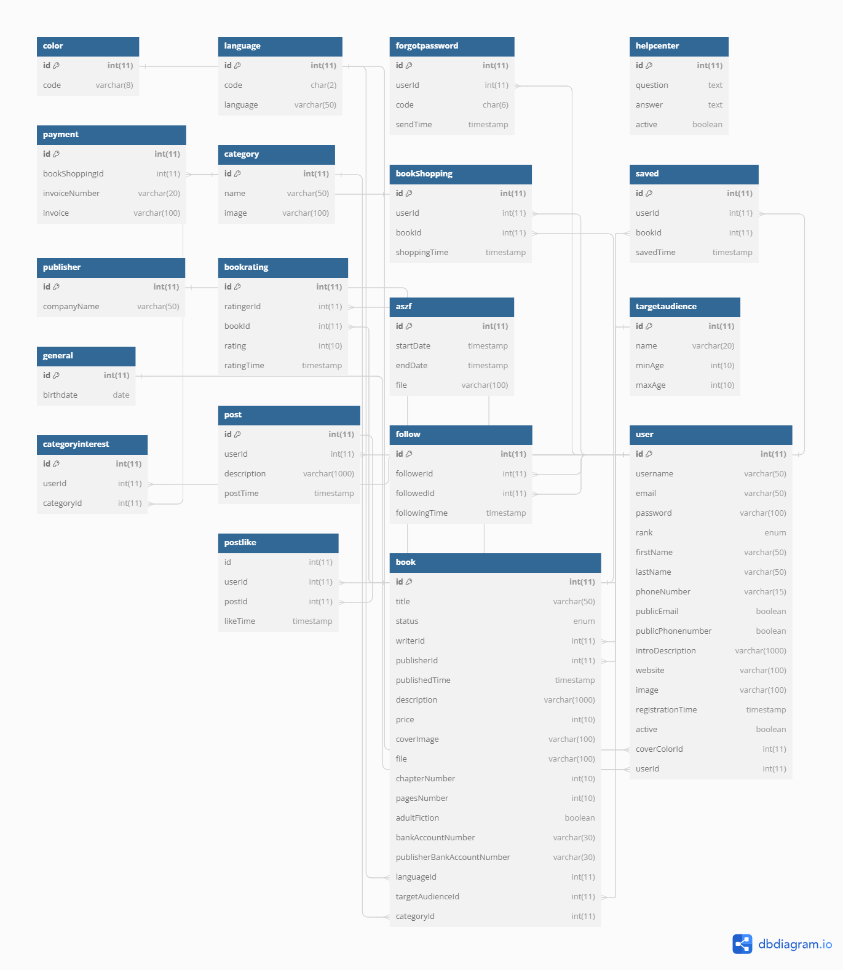

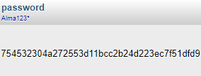
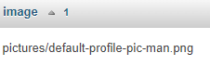
Notes:
first created
questions
xampp
relational db structure
encrypt data
optimal performance

Slide 13
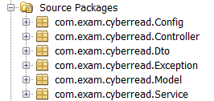

Notes:
JAX-RX
MVC
transparent, bug fix
separate layer

Slide 14
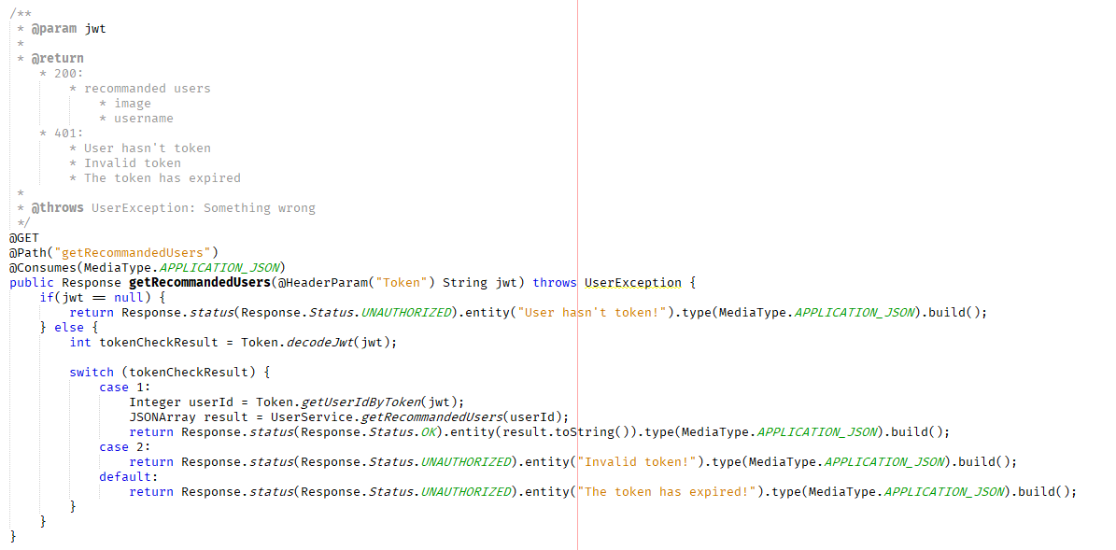
Notes:
client-server
HTTP methods

Slide 15
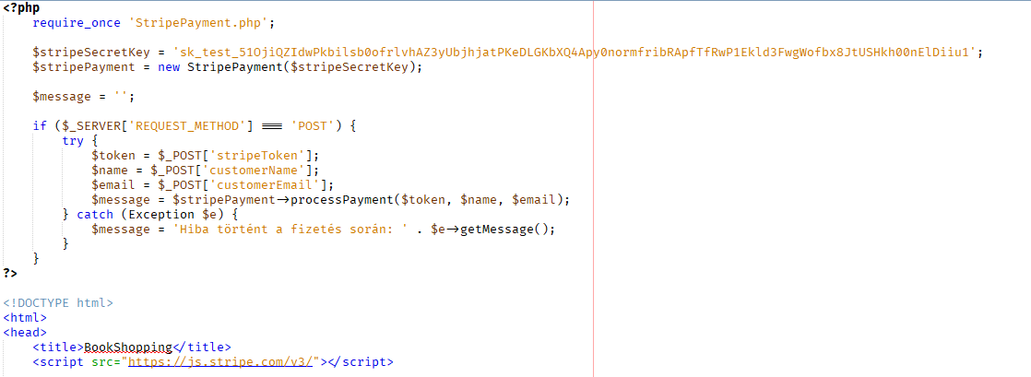

Notes:
payment and file uploading

Slide 16
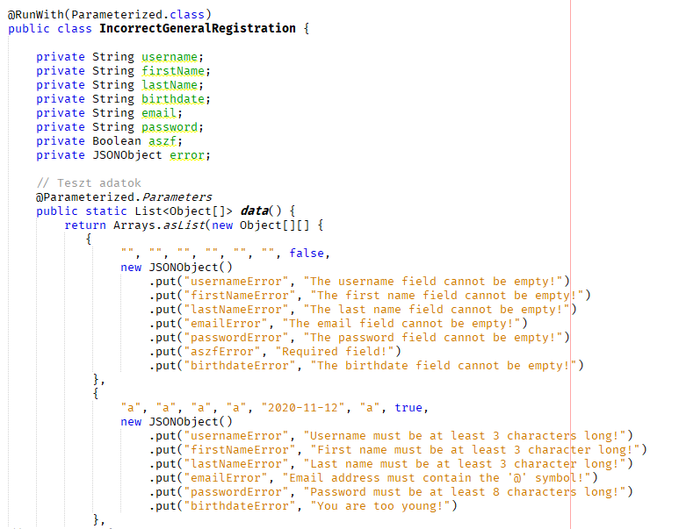
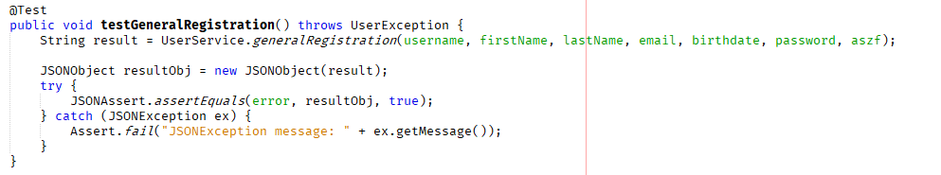
Notes:
Parameterized
all possible cases
during testing

Slide 17
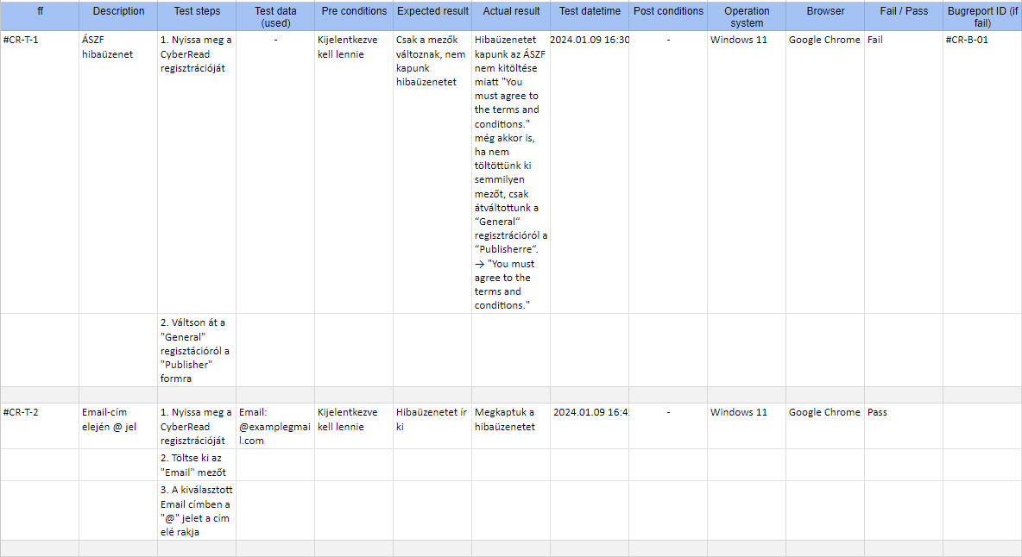
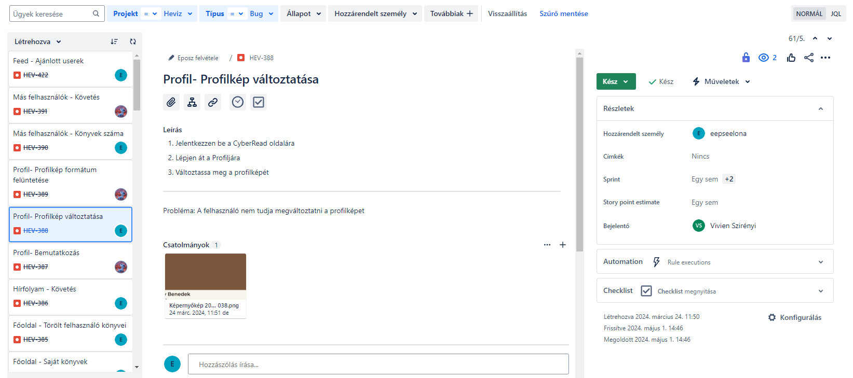
Notes:
user experience, jira bugs

